Slide 1

Geometry
Unit 11, Lesson 3 Solving Problems Involving Triangles Inscribed in Circles Volume 2, pg. 191

Slide 2


Benchmark
MA.912.GR.6.3
Solve mathematical problems involving triangles and quadrilaterals inscribed in a circle.
volume 2, pg. 191

Slide 3
Integrated Mathematical Thinking and Reasoning Standards
MA.K12.MTR.1.1 Actively participate in effortful learning both individually and collectively.
MA.K12.MTR.2.1 Demonstrate understanding by representing problems in multiple ways.
MA.K12.MTR.3.1 Complete tasks with mathematical fluency.
MA.K12.MTR.4.1 Engage in discussions that reflect on the mathematical thinking of self and others.
MA.K12.MTR.5.1 Use patterns and structure to help understand and connect mathematical concepts.
volume 2, pg. 191

Slide 4

Learning Target
I can solve mathematical problems involving triangles inscribed in a circle.
volume 2, pg. 191

Slide 5

Warm-Up
volume 2, pg. 192

Slide 6
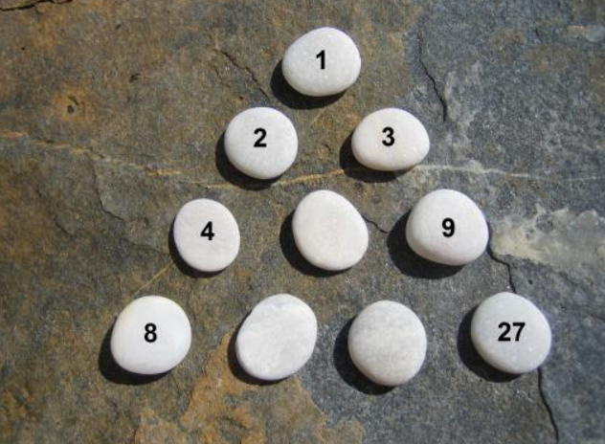
11.3.1 Warm-Up: Patterns
1. What is the first question that comes to your mind?
2. Describe the pattern used in the image.
volume 2, pg. 192

Slide 7

Exploration
volume 2, pg. 192

Slide 8

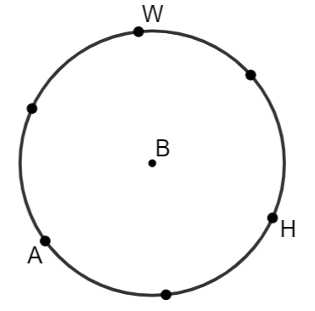
11.3.2 Exploration: Triangles Inscribed in Circles
Work with your partner to complete the following.
Elijah is constructing a triangle inscribed in Circle B and stopped after he created six points on Circle B that are the same distance from each other.
volume 2, pg. 192

Slide 9
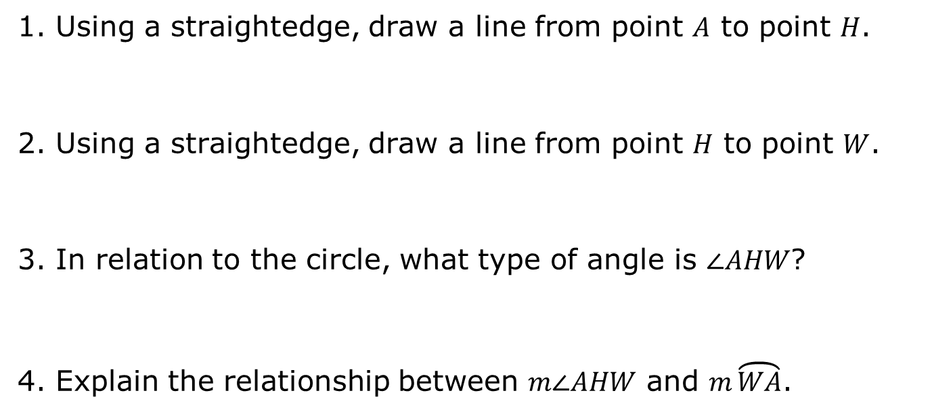
1. Using a straightedge, draw a line from point $A$ to point $H$.
2. Using a straightedge, draw a line from point $H$ to point $W$.
3. In relation to the circle, what type of angle is $∠AHW$?
4. Explain the relationship between $m∠AHW$ and $m\overset{⏜}{WA}$.
volume 2, pg. 192

Slide 10
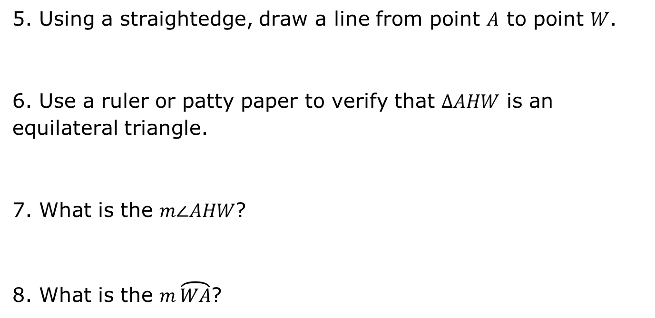
5. Using a straightedge, draw a line from point $A$ to point $W$.
6. Use a ruler or patty paper to verify that $∆AHW$ is an equilateral triangle.
7. What is the $m∠AHW$?
8. What is the $m\overset{⏜}{WA}$?
volume 2, pg. 193

Slide 11

Guided Practice
volume 2, pg. 193

Slide 12

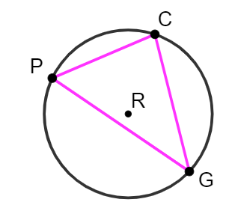

11.3.3 Guided Practice: Triangles Inscribed in Circles
Circle $R$ is shown. Points $P$, $C$, and $G$ are on circle $R$ and create $∆PCG$. $m\overset{⏜}{PG}=162°$, $m∠CPG=58°$, and $m∠PCG=(7x−17)°$.
a. What is the $m∠PCG$?
b. Find the value of $x$.
c. What is the $m∠PGC$?
volume 2, pg. 193

Slide 13
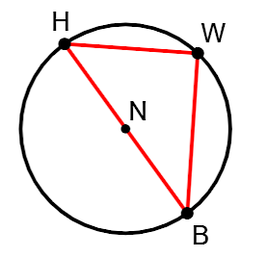

2. Circle $N$ has points $H$, $W$, and $B$ on the circle and diameter $\overline{HB}$. $∆HWB$ is inscribed in circle $N$. $m\overset{⏜}{BW}=102°$ and $m∠HBW=(4x−10)°$.
What is the $m∠HBW$?
b. Find the value of $x$.
volume 2, pg. 194

Slide 14
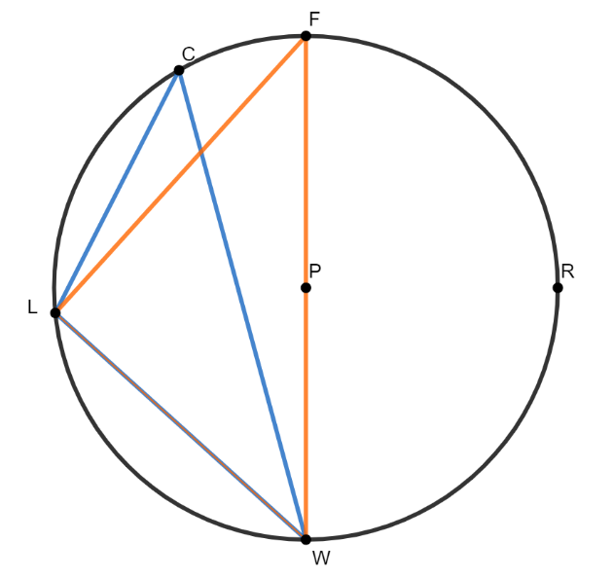
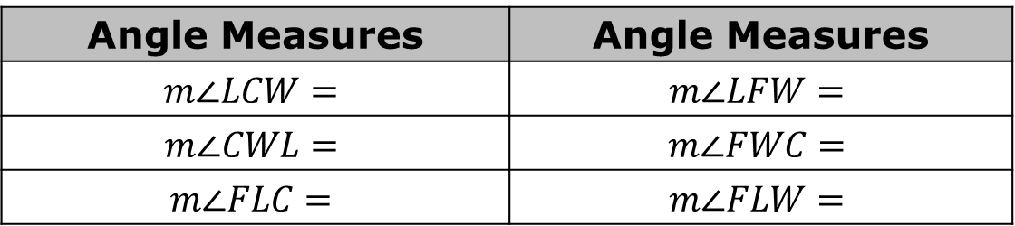

$∆CLW$ and $∆FLW$ are inscribed in Circle P, where $\overline{FW}$ is the diameter of Circle $P$. $m\overset{⏜}{FC}=(2x−6)°$, $m\overset{⏜}{LC}=(4x−6)°$, and $m\overset{⏜}{LW}=(3x+30)°$.
Complete the table.
Angle Measures | Angle Measures
$$m∠LCW=$$ | $$m∠LFW=$$
$$m∠CWL=$$ | $$m∠FWC=$$
$$m∠FLC=$$ | $$m∠FLW=$$
volume 2, pg. 194

Slide 15

Your Turn
volume 2, pg. 195

Slide 16
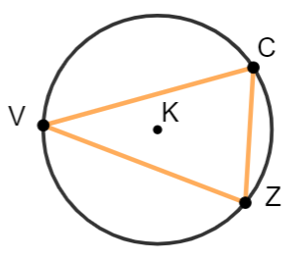

11.3.4 Your Turn!
Circle $K$ has points $V$, $C$, and $Z$ on the circle, and $∆VCZ$ is inscribed in circle $K$. $m\overset{⏜}{VC}=(9x+23)°$, $m∠CVZ=36°$, and $m∠VZC=(7x−21)°$.
What is the value of $x$?
b. What is the $m∠VCZ$?
volume 2, pg. 195

Slide 17
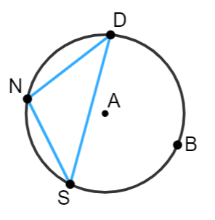
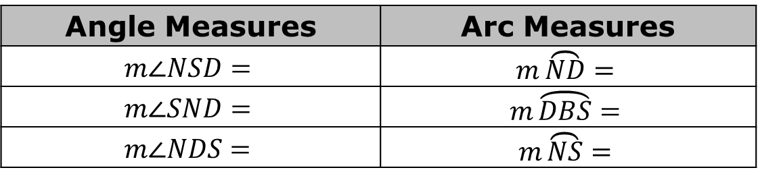

2. Circle $A$ has points $N$, $D$, $B$, and $S$ on the circle, and $∆SDN$ is inscribed in Circle $A$. $m\overset{⏜}{ND}=(7x−7)°$, $m\overset{⏜}{DBS}=(23y−5)°$, $m∠NSD=(5x−23)°$, and $m∠DNS=(8y+29)°$.
Complete the table.
Angle Measures | Arc Measures
$$m∠NSD=$$ | $$m\overset{⏜}{ND}=$$
$$m∠SND=$$ | $$m\overset{⏜}{DBS}=$$
$$m∠NDS=$$ | $$m\overset{⏜}{NS}=$$
volume 2, pg. 195

Slide 18
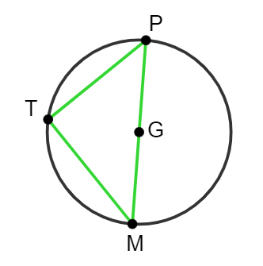

3. Circle $G$ has diameter $\overline{MP}$ and $∆MTP$ inscribed in the circle. $m∠TMP=(6x−8)°$ and $m∠TPM=(4x+13)°$.
Find the value of $x$.
b. What is the $m∠TMP$?
c. What is the $m∠TPM$?
volume 2, pg. 196

Slide 19

Wrap-Up
volume 2, pg. 196

Slide 20
11.3.5 Wrap-Up: Cool Down
Write a summary of what you learned about solving problems involving triangles inscribed in circles.
volume 2, pg. 196

